Slide 1
Integrating Machine Learning in Jupyter Notebooks
Attila Bagoly

Slide 2
Current status, analyzing steps
We use the well known TMVA methods, train selected models with our data
Evaluating: after we finished the results will be saved in a root file, we can make visualization from that
But: output file contains raw histograms
TMVAGui: methods to make nice histograms from the output file
But: not for notebook environment
f = TFile(TMVAOutputFile) dir_dataset = f.GetDirectory(datasetName) dir_dataset.cd() TMVA.plot_efficiencies(f, 2, dir_dataset) ROOT.c.Draw()

Slide 3
Goal
Jupyter notebook:
Interactive coding environment
Document: HTML, Markdown support
Shareable: nbviewer, binder
Integrating TMVA in Jupyter:
Support for TMVAGui in notebooks with nice interface
Interaction: changes modify the state of TMVA
Example (possibility): transformations in input data and then Factory will use that selected transformations

Slide 4
Steps
TMVAGui visualizations:
To forget: saving output file, reading back, visualizing the results
Instead: visualization directly from Factory and DataLoader
=> Nice interface: loader.drawCorrelationMatrix()
Interactive interface:
First: every visualization in JavaScript using JsROOT and D3.js
Buttons, lists in JS plot, which is able to make changes in server state: ipywidgets
Interactive feedback from training: Cross validation and test errors for methods
Interaction with input variable histograms
etc

Slide 5
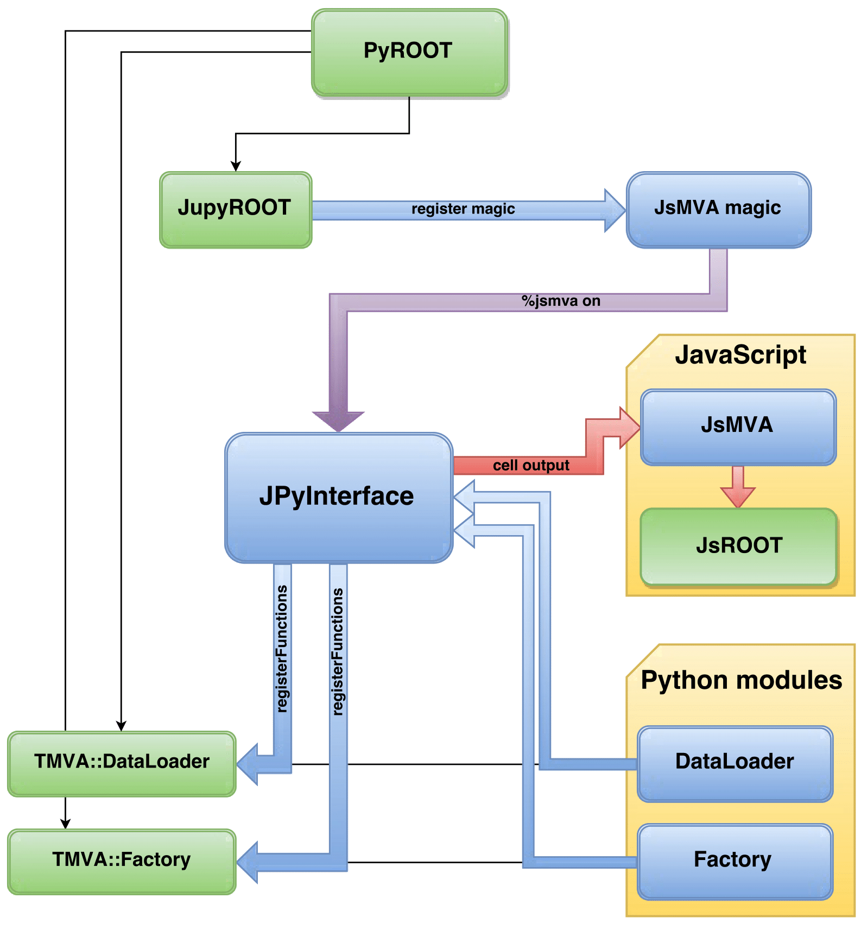
Design
Importing JsMVA will register new magic
%jsmva on: JPyInterface inserts new methods to TMVA.DataLoader and TMVA.Factory
New methods: inserting HTML to cell output, with JavaScript call for JsMVA.js
JsMVA.js using JsROOT to create JavaScript plots

Slide 6
Past few weeks
Histogram for input variables
Add transformations to input and make histogram
Draw correlation matrix
Classifier output distribution
Classifier Probability Distributions
Classifier cut efficiencies
ROC curve
Visualization for neural networks

Slide 7
Results
http://nbviewer.jupyter.org/github/qati/GSOC16/blob/master/notebooks/ROOTbooks-TMVA-00.ipynb?flush_cache=true

